Slide 1
JavaScript

Slide 2
Javascript
1995: “Mocha” project at Netscape
Javascript takes off, included in Microsoft’s IE
1996: submitted to Ecma as standard

Slide 3
Today
Java alive and well server-side
but JS dominates client-side
making inroads server-side too (eg, node.js)

Slide 4
An outstanding dynamic programming language
Primitive data types
Objects: Mutable and unmutable

Slide 5
syntax
statements like Java
while, for, if, switch, try/catch, return, break, throw comments
use //, avoid /**/
semicolons inserted if omitted (yikes!)
declarations
function scoping with var
functions are expressions;
closures (yippee!)

Slide 6
Variables
A variable is a name associated with a piece of data
Variables allow you to store and manipulate data in your programs
Think of a variable as a mailbox which holds a specific piece of information

Slide 7
Variables
In JavaScript variables are created using the keyword var
Example:
var x = 10;
var y = 17;
var color = “red”;
var name = “Katie”;

Slide 8
Variables
It is vitally important to distinguish between the name of the variable and the value of the variable
For example, in the expression var color=“red”, color is the name of the variable and red is the value. In other words, color is the name of the box while red is what is inside the box

Slide 9
Data Types
Primitive Data Types
  Numbers
  Strings
  Boolean (True, False)
Composite Data Types
  Arrays
  Objects

Slide 10
Primitive Data Types
Numbers - A number can be either an integer or a decimal
Strings - A string is a sequence of letters or numbers enclosed in single or double quotes
Boolean - True or False

Slide 11
Variables & Data Types
JavaScript is untyped; It does not have explicit data types
For instance, there is no way to specify that a particular variable represents an integer, string, or real number
The same variable can have different data types in different contexts

Slide 12
Implicit Data Types
Although JavaScript does not have explicit data types, it does have implicit data types
If you have an expression which combines two numbers, it will evaluate to a number
If you have an expression which combines a string and a number, it will evaluate to a string

Slide 13
Example: Variables
var x = 4;
var y = 11;
var z = “cat”;
var q = “17”;
Ans = x + y;
Ans => 15
Ans = z + x;
Ans => cat4
Ans = x + q;
Ans => 417

Slide 14
More Examples
var x = 4;
var y = 11;
var z = “cat”;
var q = “17”;
Ans = x + y + z;
Ans => 15cat
Ans = q + x + y;
Ans => 17411

Slide 15
typeof(1) "number”
typeof(false) "boolean“
typeof('a')’ "string“
typeof([]) "object“
typeof({}) "object“
typeof(null) "object"
note: no array ‘type’
typeof(function () {}) "function" typeof(undefined) "undefined" typeof(typeof(1)) "string“
note: no type type

Slide 16
funny values undefined: lookup, non-existent thing null: special return value
equality
use ===, !==
Ex:
1 === 1 true
1.0 === 1 true
'hello' === 'hello' true
[] === [] false

Slide 17
Arrays
An array is a compound data type that stores numbered pieces of data
Each numbered datum is called an element of the array and the number assigned to it is called an index.
The elements of an array may be of any type. A single array can even store elements of different type.

Slide 18
Creating an Array
There are several different ways to create an array in JavaScript
Using the Array() constructor:
  - var a = new Array(1, 2, 3, 4, 5);
  - var b = new Array(10);
Using array literals:
- var c = [1, 2, 3, 4, 5];

Slide 19
Accessing Array Elements
Array elements are accessed using the [ ] operator
Example:
  var colors = [“red”, “green”, “blue”];
  colors[0] => red
  colors[1] => green

Slide 20
Adding Elements
To add a new element to an array, simply assign a value to it
Example:
var a = new Array(10);
a[50] = 17;

Slide 21
Array Length
All arrays created in JavaScript have a special length property that specifies how many elements the array contains
Example:
  var colors = [“red”, “green”, “blue”];
  colors.length => 3

Slide 22
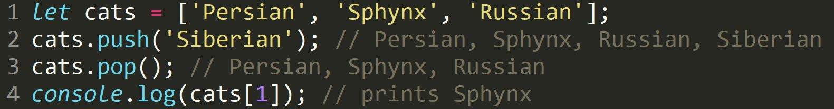
Accessing Arrays
JS is 0-indexed

Slide 23
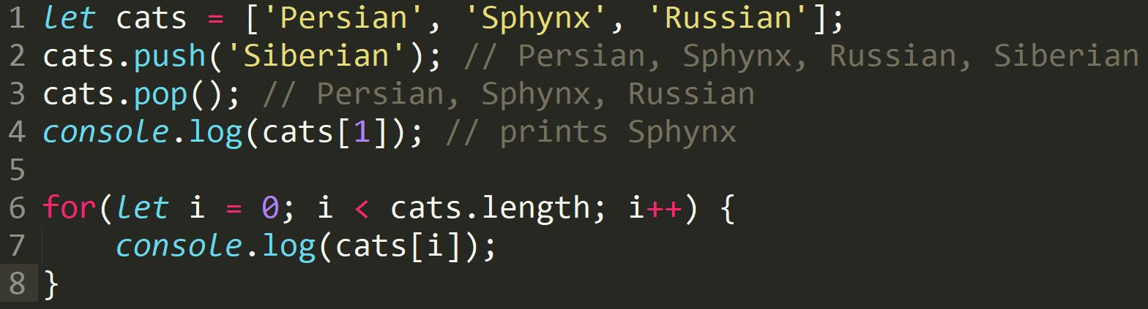
For Loops

Slide 24
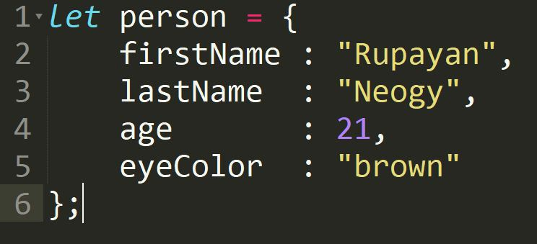
Objects
A JavaScript object is a collection of key-value pairs.
Kinda looks like CSS
keys
values

Slide 25


Slide 26
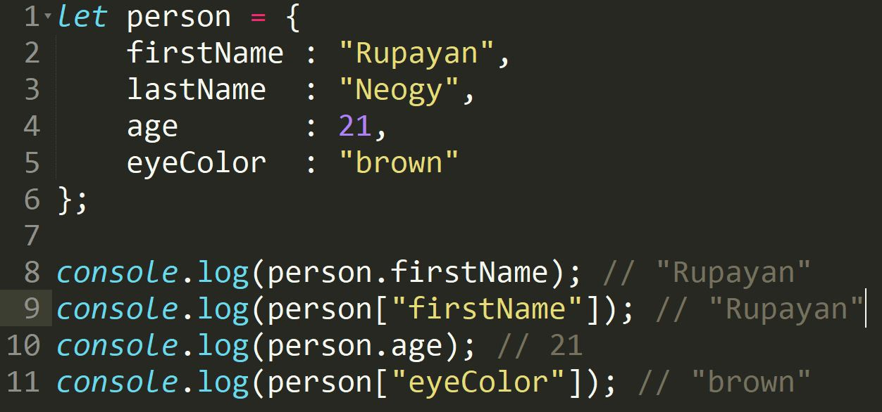
Objects (accessing fields)

Slide 27
Primitive Data Types versus Composite Data Types
Variables for primitive data types hold the actual value of the data
Variables for composite types hold only references to the values of the composite type

Slide 28
Variable Names
JavaScript is case sensitive
Variable names cannot contain spaces, punctuation, or start with a digit
Variable names cannot be reserved words

Slide 29
Programming Tips
It is bad practice to change the implicit type of a variable. If a variable is initialized as a number, it should always be used as an number.
Choose meaningful variable names

Slide 30
Statements
A statement is a section of JavaScript that can be evaluated by a Web browser
A script is simply a collection of statements
Examples:
Last_name = “Dunn”;
x = 10 ;
y = x*x ;

Slide 31
Programming Tips
It is a good idea to end each program statement with a semi-colon; Although this is not necessary, it will prevent coding errors
Recommended:
  a = 3;
  b = 4;
Acceptable:
a = 3; b = 4;
Wrong:
  a =
  3;

Slide 32
Operators
+ Addition
Subtraction
* Multiplication
/ Division
% Modulus
++ Increment
- - Decrement
= = Equality
! = Inequality
! Logical NOT
&& Logical AND
|| Logical OR
? Conditional Selection

Slide 33
Aggregate Assignments
Aggregate assignments provide a shortcut by combining the assignment operator with some other operation
The += operator performs addition and assignment
The expression x = x + 7 is equivalent to the expression x += 7

Slide 34
Increment and Decrement
Both the increment (++) and decrement (- -) operator come in two forms: prefix and postfix
These two forms yield different results
x = 10; x = 10;
y = ++ x; z = x ++;
y = 11
z = 10
x = 11 in both cases

Slide 35
Control Structures
There are three basic types of control structures in JavaScript: the if statement, the while loop, and the for loop
Each control structure manipulates a block of JavaScript expressions beginning with { and ending with }

Slide 36
The If Statement
The if statement allows JavaScript programmers to a make decision
Use an if statement whenever you come to a “fork” in the program
if ( x = = 10)
{ y = x*x;
}
else
{ x = 0;
}

Slide 37
Repeat Loops
A repeat loop is a group of statements that is repeated until a specified condition is met
Repeat loops are very powerful programming tools; They allow for more efficient program design and are ideally suited for working with arrays

Slide 38
The While Loop
The while loop is used to execute a block of code while a certain condition is true
count = 0;
while (count <= 10) {
document.write(count);
count++;
}

Slide 39
The For Loop
The for loop is used when there is a need to have a counter of some kind
The counter is initialized before the loop starts, tested after each iteration to see if it is below a target value, and finally updated at the end of the loop

Slide 40
Example: For Loop
// Print the numbers 1 through 10
for (i=1; i<= 10; i++)
document.write(i);
i=1 initializes the counter
i<=10 is the target
value
i++ updates the
counter at the end
of the loop

Slide 41
Example: For Loop
<SCRIPT LANGUAGE=
"JavaScript">
document.write("1");
document.write("2");
document.write("3");
document.write("4");
document.write("5");
</SCRIPT>
<SCRIPT LANGUAGE=
"JavaScript">
for (i=1; i<=5; i++)
document.write(i);

Slide 42
Functions
Functions are a collection of JavaScript statement that performs a specified task
Functions are used whenever it is necessary to repeat an operation

Slide 43
Functions
Functions have inputs and outputs
The inputs are passed into the function and are known as arguments or parameters
Think of a function as a “black box” which performs an operation

Slide 44
Defining Functions
The most common way to define a function is with the function statement.
The function statement consists of the function keyword followed by the name of the function, a comma-separated list of parameter names in parentheses, and the statements which contain the body of the function enclosed in curly braces

Slide 45
Example: Function
function square(x)
{return x*x;}
z = 3;
sqr_z = square(z);
Name of Function: square
Input/Argument: x
Output: x*x

Slide 46
Example: Function
function sum_of_squares(num1,num2)
{return (num1*num1) + (num2*num2);}
function sum_of_squares(num1,num2)
{return (square(num1) + square(num2));}

Slide 47
Writing output
Writing into an HTML element, using innerHTML.
Writing into the HTML output using document.write().
Writing into an alert box, using window.alert().
Writing into the browser console, using console.log().

